Slide 1

Futurense
Democratizing Tech Talent to deliver impact at scale

Slide 2
Big Data Stock Analysis
Guided by
Venkat S Billa(DE Expert)
Presented by
Niharika J S – FT701

Slide 3
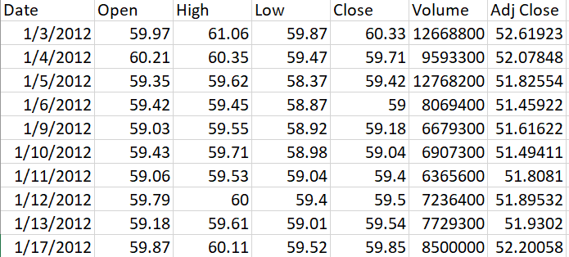
DATA PREVIEW:
Date: The date when the stock was traded.
Open: The initial price at which a stock is traded during a business day.
High: The highest price at which a stock is traded during a trading day.
Low: The lowest price at which a stock is traded during a trading day.
Close: The final price of a stock at the end of a trading session.
Volume: The number of shares of a stock traded during a specific period.
Adjusted Close: The stock's closing price after accounting for dividends.

Slide 4
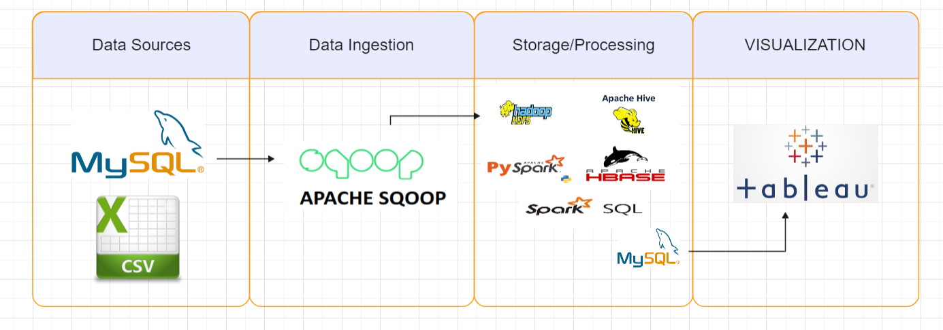

ARCHITECTURE:

Slide 5
STEPS:
Create a new column ‘stock_name’ and combine all the four stock tables as a single table
1. Load the provided CSV files into MySQL tables.
2. Import the MySQL tables into Hive warehouse using Sqoop.
3. Optimize data analysis in Hive using techniques like partitioning and bucketing.
4. Store the analysis results as external tables in HDFS.
5. Create MySQL tables to store the output data.
6. Export the output data from HDFS to MySQL using Sqoop.
7. Visualize the data using Tableau, Power BI, or Python.

Slide 6
HIVE ANALYSIS
Table Creation in MySQL:
create table walmart_stocks (date Date, open float, high float, low float, close float, volume float, adj_close float)
Loading File from Local to MySQL:
LOAD DATA INFILE '/home/cloudera/walmart_stock.csv' INTO TABLE stocks FIELDS TERMINATED BY ',' LINES TERMINATED BY '\n’;
Sqoop import -> Hive warehouse:
sqoop import --connect jdbc:mysql://localhost:3360/stocks --username root --password cloudera --hive-import --table walmart_stocks -m 1

Slide 7
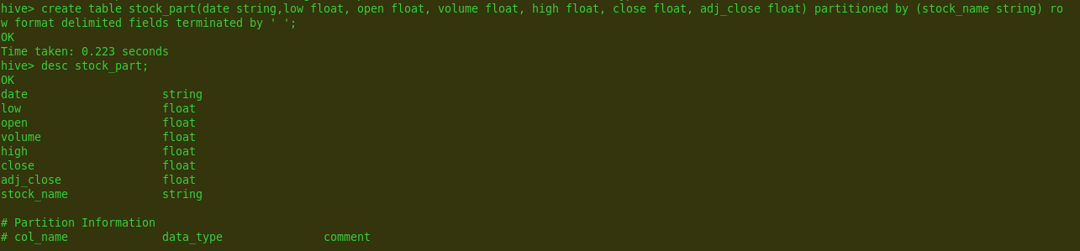
Optimization using partitioning:
create table stock_part(date string,low float, open float, volume float, high float, close float, adj_close float) partitioned by (stock_name string) row format delimited fields terminated by ' ';

Slide 8
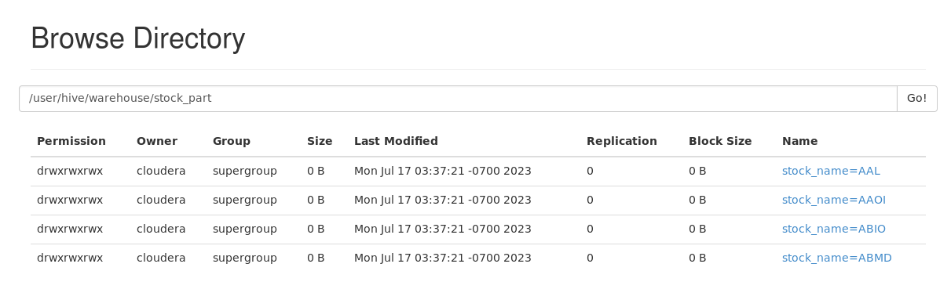

Slide 9
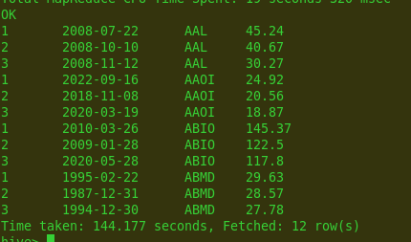
Scenario 1: Write a Hive query to identify the top three dates that experienced the largest percentage change in stock price (from open to close) for every stock.
Without Partitioning:
with cte as (select date, stock_name, round(abs(((close - open) / open) * 100), 2) as percentage_change from walmart_stocks) ,
cte2 as
(select date, stock_name, percentage_change, row_number() over(partition by stock_name order by percentage_change desc) as rn from cte)
select rn, date, stock_name, percentage_change from cte2 where rn <= 3;

Slide 10
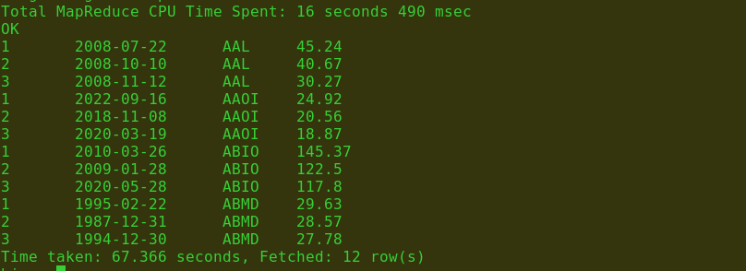
With Partitioning:
with cte as (select date, stock_name, round(abs(((close - open) / open) * 100), 2) as percentage_change from stock_part) ,
cte2 as
(select date, stock_name, percentage_change, row_number() over(partition by stock_name order by percentage_change desc) as rn from cte)
select rn, date, stock_name, percentage_change from cte2 where rn <= 3;

Slide 11
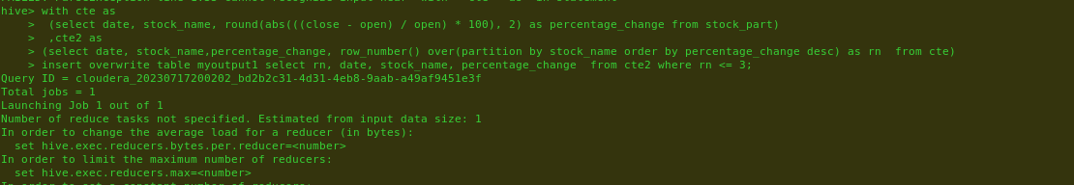
External table creation:
create external table myoutput1(row_num int, date string, stock_name string, percentage float) row format delimited fields terminated by ' ' location '/user/hive/warehouse/myoutput1/result1.txt’;
Transferring output data to external table:

Slide 12
MySQL table(client database) to store output data:
create table scenario1(Row_num int,stock_date date, Stock_name varchar(20),Percentage_change float);
Sqoop command to transfer o/p table to MySQL :
sqoop export --connect jdbc:mysql://localhost:3306/stocks --username root --password cloudera --table scenario1 --export-dir /user/hive/warehouse/myoutput1/result1.txt/000000_0 --input-fields-terminated-by ','

Slide 13
PySpark Analysis:
IMPORT LIBRARIES:
import pyspark
from pyspark.sql import SparkSession
from pyspark.sql.functions import *
READ DATAFILES:
spark1 = SparkSession.builder.appName('Walmart_project').getOrCreate()
df=spark1.read.csv("walmart_stock.csv",inferSchema=True,header=True)

Slide 14
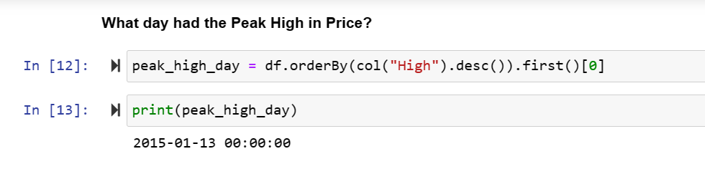
Scenario : What day had the Peak High in Price?

Slide 15
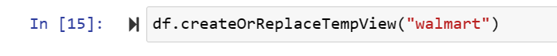
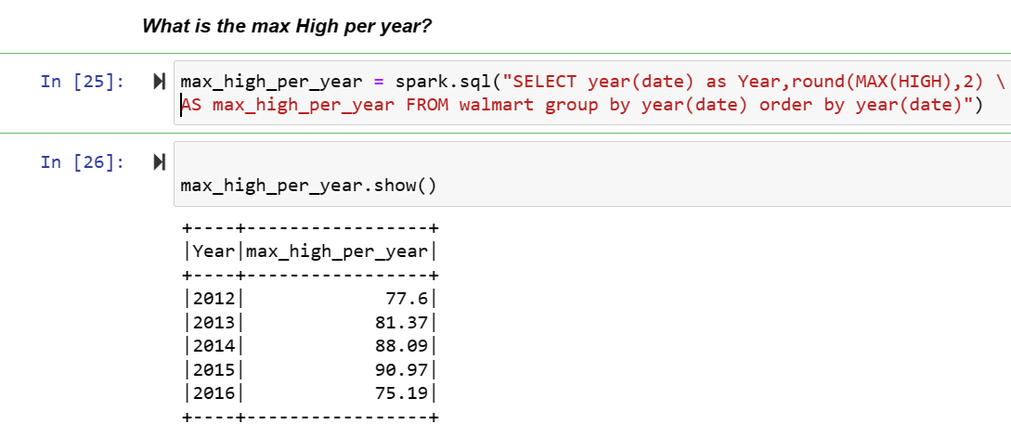
SparkSQL Analysis

Slide 16
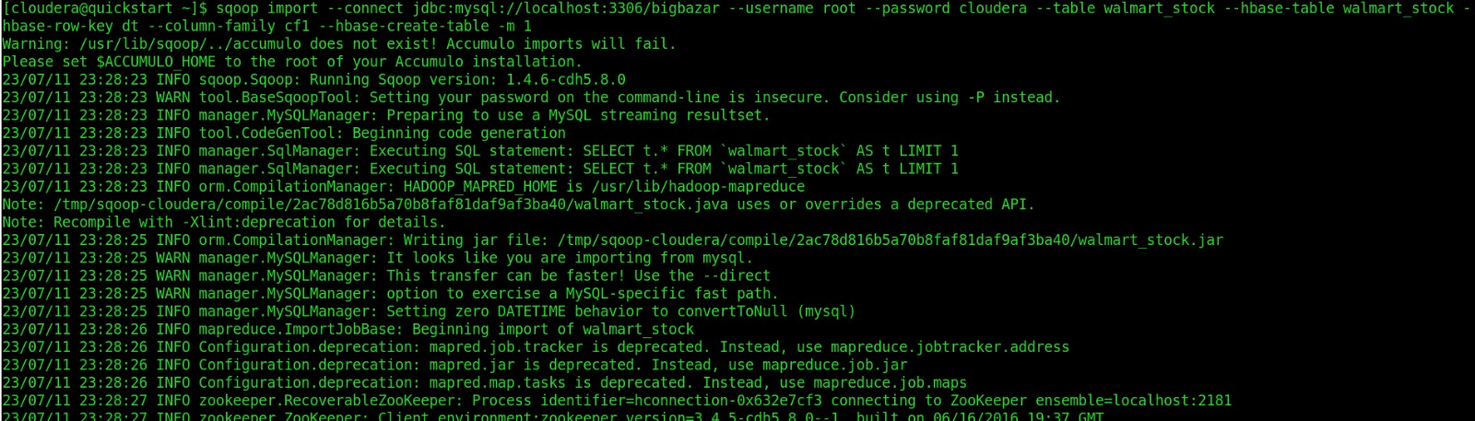
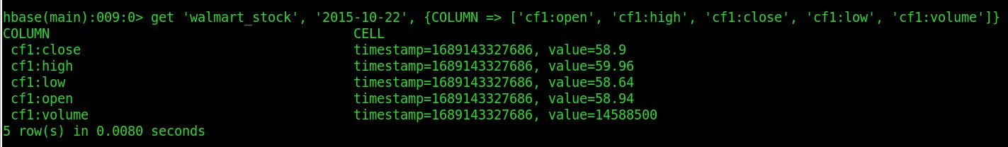
HBASE ANALYSIS: Print out first 5 columns

Slide 17
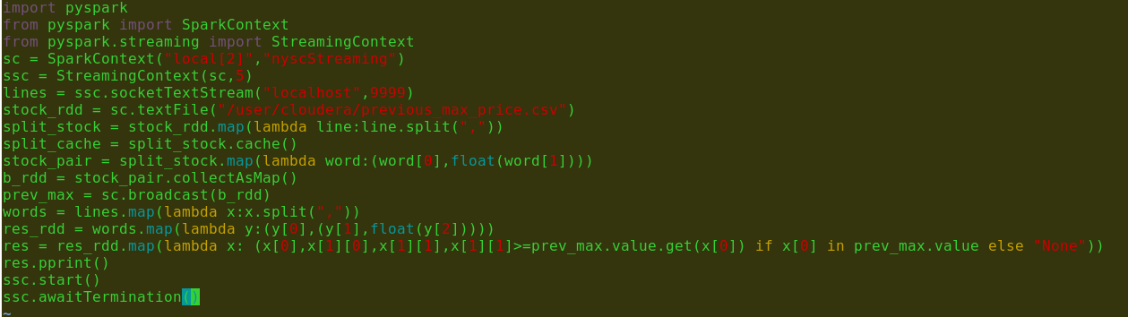
SparkStreaming Analysis:
Compares the current stock price of each company from the data stream with the static data of previous max price and
Flags i.e. displays the details when the current price reaches or goes above the previous max price.

Slide 18
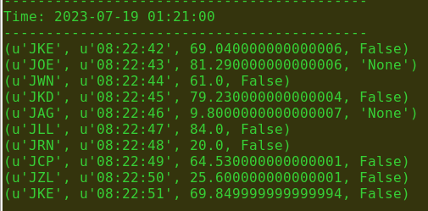
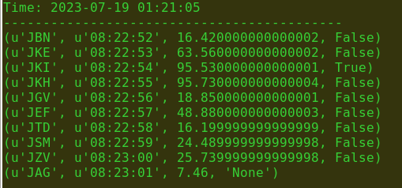
OUTPUT:

Slide 19
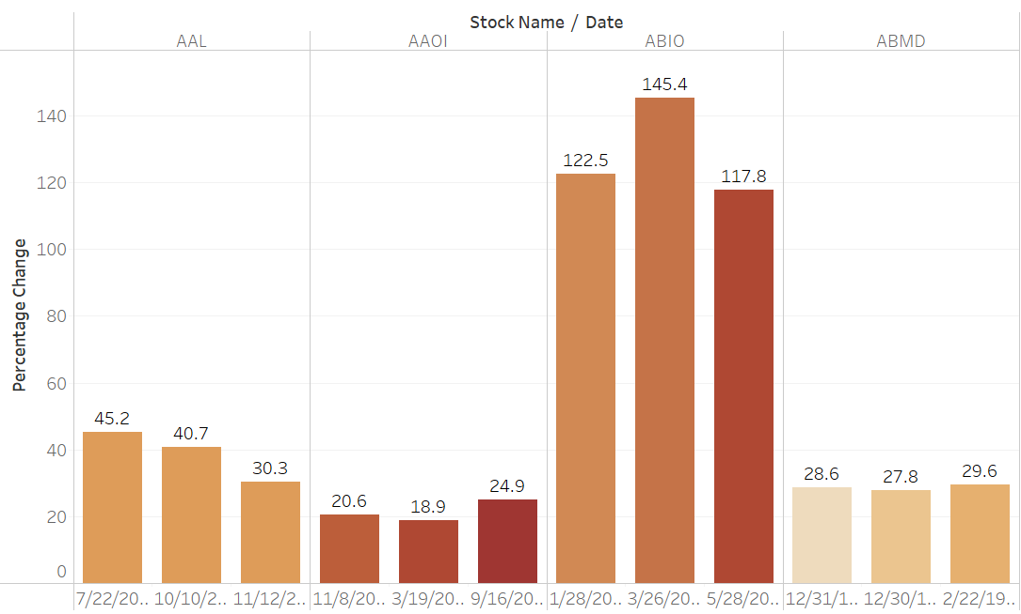
VISUALIZATIONS
(Tableau)
Top three dates that experienced the largest percentage change in stock price (from open to close)

Slide 20
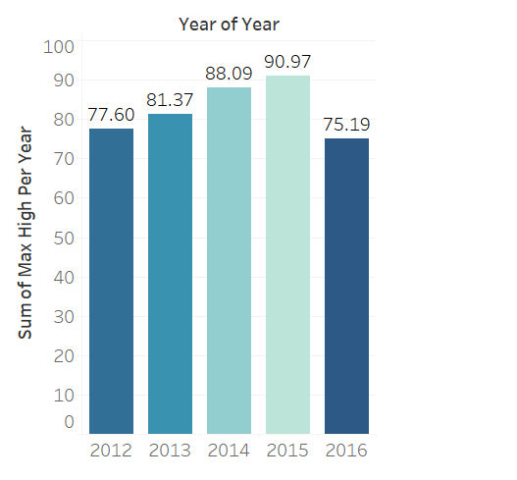
Maximum High Per Year

Slide 21
Thank You

